Slide 1
Methods of Feedback
DPDD Occupational Specialism
Week 17

Slide 2
Questionnaires

Slide 3
Questionnaire
A structured set of questions
Given to users after interacting with a system
Used to collect consistent feedback
Same questions for all users in a group (technical or non-technical)
Answers can be compared
Feedback can be summarised and analysed

Slide 4
Closed questions (quantitative)
Fixed answers
Yes or No
Rating scale
Multiple choice
Why use closed questions
Easy to compare
Easy to count
Identify patterns quickly
Here are some clear examples of closed questions suitable for questionnaire use:
Were you able to complete the task successfully?
Yes
No
How easy was the system to use?
Very easy
Easy
Neutral
Difficult
Very difficult

Slide 5
Open questions (qualitative)
Free text answers
User explains their experience
User suggests changes
Why use open questions
Explains why issues happened
Reveals unexpected problems
Adds context to closed answers
Here are five clear examples of open questions suitable for questionnaires:
Which part of the system did you find most difficult to use, and why?
Were there any points where you felt unsure what to do next? Explain.
What, if anything, did not work as you expected?
What changes would you suggest to improve the system?
Are there any other issues or observations you would like to report?

Slide 6
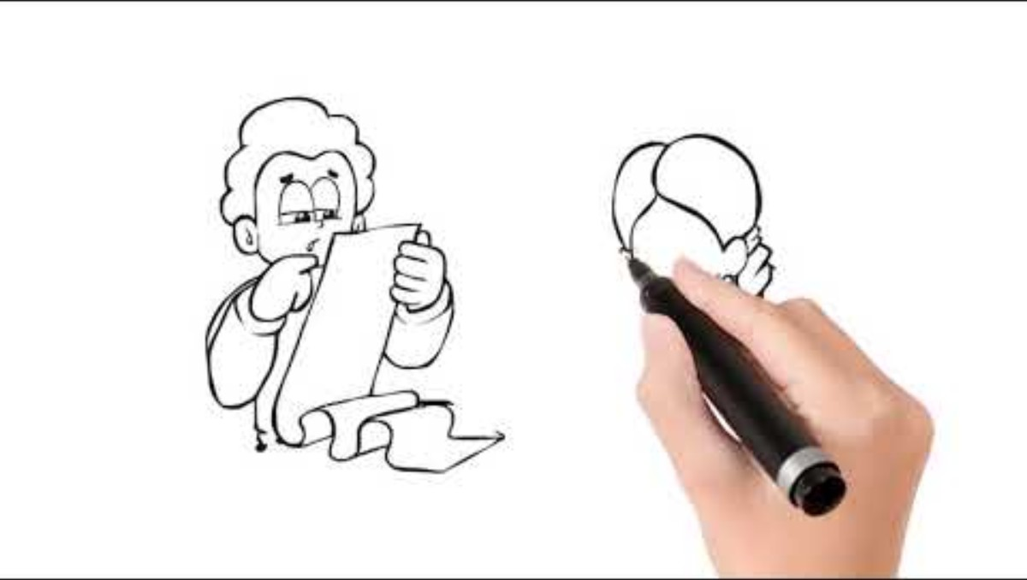

Slide 7
Non-technical users
Focus on using the system
No access to code
Black box perspective
What these questions test
Usability
Clarity
Task success
User experience
Questions for non-technical users
Was the task easy to complete?
Were the instructions clear?
Did the system behave as expected?
Where did you get stuck?

Slide 8
Technical users
Understand how systems work
May view code or logic
Black box and white box perspectives
What these questions test
Logic
Validation
Performance
Structure
Questions for technical users
Did the logic handle all inputs correctly?
Were errors validated properly?
Were there any performance issues?
Is the code easy to understand and maintain?

Slide 9
Why use a questionnaire?
Collect evidence
Identify problems
Inform changes to the prototype
Before writing questions
Who is the user?
What is being tested?
What decisions will this support?

Slide 10
Software needed
Google forms

Slide 11


Slide 12
Screencasts

Slide 13
What is a screencast?
A screencast is a recorded video of someone using a system or completing a task on‑screen.
It may include audio commentary or captions.
It shows exactly what the user did and how the system responded.

Slide 14
Why use screencasts?
Capture real user behaviour
Provide visual evidence
Show steps that questionnaires can’t
Help identify errors, misunderstandings, and inefficient actions
Allow repeated review for analysis
Useful for comparing technical and non‑technical users
Or to provide supporting information to go with the questionnaire

Slide 15
What user screencasts show
How long tasks take
Where users hesitate
Missclicks, confusion, repeated actions
Unexpected system behaviour
Navigation choices
How instructions are interpreted
Whether the interface supports or hinders task success

Slide 16
Screencasts of non‑technical users
Focus:
Using the system naturally; following instructions; locating features.
Used to record what the user does, can support observations
What this reveals:
Usability
Clarity of the interface
Confidence levels
Points of confusion
Whether the user forms wrong assumptions
What to look for:
Do they know where to click first?
Do they search menus randomly?
Do they miss on‑screen cues?
Do they complete the task without support?

Slide 17
Screencasts of technical users
Focus:
Understanding logic; spotting structural issues; testing edge cases.
What this reveals:
How the system handles unexpected inputs
Whether logic flows as intended
Performance issues (lag, errors)
Underlying assumptions about data handling
Efficiency of the workflow
What to look for:
Do they deliberately test edge paths?
Do they identify validation gaps?
Do they notice performance flaws?
Do they use features differently from non‑technical users?

Slide 18
Good practice when collecting user screencasts
Ask users to narrate what they think the system should do
Keep instructions minimal to observe natural behaviour
Ensure audio and visual clarity
Use consistent tasks across users
Record enough user sessions to spot patterns
Store securely

Slide 19
What to review before creating a screencast task
Who is the user?
What actions should they attempt?
What system behaviour are you testing?
How will the screencast support decisions about improvements?
What evidence is needed for OS assessment?

Slide 20
Creating Screencasts to Support the Questionnaire
Why create a screencast for users?
If users cannot access the prototype directly, a screencast allows them to see the system in action before completing the questionnaire.
This ensures feedback is still evidence‑based and consistent.
Using a screencast helps users to:
Understand the workflow
Observe key features
Identify usability or logic issues
Provide informed responses to closed and open questions
Participate without needing technical access or login credentials

Slide 21
What the screencast must show
To support a meaningful questionnaire, the screencast must cover:
The task flow
Expected system behaviour
Real interactions
Enough detail to judge usability
The questionnaire and the screencast must be designed together.

Slide 22
1. The task flow
Start point
Key actions
End point
Any success or error messages

Slide 23
2. Expected system behaviour
What should happen at each step
Visual cues
Navigation routes

Slide 24
3. Real interactions
Actual clicks
Hover states
Form filling
System responses
Timing (delays, loading, errors)

Slide 25
4. Enough detail to judge usability
Layout
Labelling
Menu structure
Feedback provided to the user
Any unclear or confusing elements

Slide 26
How to create an effective screencast
Plan the scenario
Record the core interaction
Highlight points the questionnaire asks about (in the same order!)
Keep the screencast concise

Slide 27
1. Plan the scenario
Choose a task that represents the purpose of the prototype.
Keep it simple and realistic so users can follow it without interacting themselves.
Decide:
What task you will demonstrate
What outcome you want the viewer to assess
Which questionnaire questions this screencast will support

Slide 28
2. Record the core interaction
When recording:
Optional but helpful:
Capture the full screen
Keep the cursor movements clear and intentional
Use slow, deliberate actions
Avoid jumping between windows
Ensure text and buttons are readable
Add spoken narration
Add on‑screen captions for clarity
Zoom briefly on key UI elements

Slide 29
3. Highlight points the questionnaire asks about
If the questionnaire includes questions on usability, clarity, or task difficulty, make sure these appear clearly.
If the questionnaire asks, “Were the instructions clear?”, show:
Where instructions appear
How the system guides the user
Any warnings, prompts, or tooltips
If the questionnaire asks, “Did the logic handle inputs correctly?”, include:
Valid and invalid inputs
Error handling
Any validation messages

Slide 30
4. Keep the screencast concise
Ideal length: 1–3 minutes
Enough to provide evidence, but not overwhelming.
Remove:
Long pauses
Unnecessary commentary
Repetitive steps

Slide 31
What users should focus on when watching
You can include a brief prompt before the questionnaire, such as:
“While watching the screencast, note whether the system is clear, easy to follow, and behaves as you expect at each step.”
Users should look for:
Confusing steps
Slow or unclear interactions
Unexpected system behaviour
Points where they would hesitate
Any features that seem missing

Slide 32
Software needed
OBS or Teams
Canva or another video editor

Slide 33
Observations

Slide 34
What are observations?
Observations involve watching a user interact with a system or prototype in real time.
The goal is to record what the user actually does, not what they say they do.
Observations capture:
Behaviour
Navigation choices
Confusion points
Success/failure moments
Emotional responses (frustration, confidence, hesitation)

Slide 35
Why use observations?
Observations allow you to see authentic user behaviour that surveys alone won’t reveal.
They help you:
Identify usability issues quickly
Understand how users interpret the interface
Spot mismatches between system design and user expectations
Collect unbiased evidence (users don’t always self‑report accurately)
Validate or challenge questionnaire responses
Gather rich qualitative data

Slide 36
Types of observation
Direct observation
Indirect observation

Slide 37
1. Direct observation
The observer watches the user in real time while the user completes the task.
The observer takes notes without interfering.
Suitable for:
Usability
Task flow
Identifying confusion points
Behavioural patterns

Slide 38
2. Indirect observation
The observer reviews a recording (e.g., screencast or session capture) instead of watching live.
Suitable when:
The user cannot attend in person
You want to replay moments
You need consistent evidence across all assessors
This links directly to the screencast method.

Slide 39
User behaviour
Where the user hesitates
Whether the user skims, reads, or ignores instructions
The order in which elements are clicked
Whether they take logical or unexpected routes
Signs of confusion (hovering, repeating, scanning menus)

Slide 40
System behaviour
Errors
Slow responses
Unclear feedback
Layout issues
Visual cues users miss

Slide 41
Task completion
Whether the user succeeds
How long it takes
How many attempts
Points where help might be needed

Slide 42
Observations for non‑technical users
Non‑technical users work from a pure usability perspective.
Observations reveal:
Whether the user knows where to start
If the design feels intuitive
Whether instructions are clear enough
Where the user gets stuck
Whether they rely on guesswork
Look for:
Repeated clicks
Menu scanning
Hovering without action
Misinterpreting labels or icons

Slide 43
Observations for technical users
Technical users may explore deeper behaviour or edge cases.
Observations reveal:
Logic weaknesses
Validation failures
Performance issues
Unclear or inconsistent design
Assumptions the system makes about inputs
Look for:
Deliberate testing of unusual paths
Attempts to break the system
Responses to unexpected inputs
Comments about structure, flow, or data

Slide 44
Good practice for conducting observations
Do not lead the user or explain anything once the task begins
Keep instructions short and neutral
Stay silent unless safety or safeguarding requires intervention
Use a consistent observation sheet or template
Focus on behaviour, not personal judgement
Capture time‑stamped notes where possible
Store notes in line with DPDD and organisational data handling policies

Slide 45
How observations support the questionnaire
Observations allow you to:
Compare what users say (questionnaire) with what they do (observations)
Validate findings across multiple methods
Identify reasons behind certain answers
Make evidence‑based suggestions for improvements
Build a balanced picture of usability and logic performance

Slide 46
Before carrying out observations, ask:
Who is the user?
What task are they completing?
What evidence do I need for assessment?
What behaviours am I looking for?
How will the observation link to the questionnaire and screencast?

Slide 47
Observation Checklists
Look at the observation checklist now

Slide 48
Paired Coding Review

Slide 49
What is a paired coding review?
A paired coding review is when two people sit together and examine the code behind a prototype or system.
One person explains the code, and the other asks questions, challenges logic, and checks understanding.
It provides a structured way to test:
Logic
Validation
Data handling
Efficiency
Code structure and clarity
Error management
Assumptions the developer has made
This method works only when the user has access to the code.

Slide 50
Why use paired coding reviews?
Paired coding reviews help you collect evidence about the quality of the underlying solution — not just the interface.
They allow you to:
Identify mistakes in logic
Find errors that do not appear during basic testing
Check whether code follows standards
Spot repeated or inefficient sections
Understand how data moves through the programme
Validate edge cases
Detect security or validation gaps
Improve the reliability of the prototype before further testing

Slide 51
Roles in a paired coding review
Driver (explainer)
Navigator (reviewer)

Slide 52
1. Driver (explainer)
The person who wrote the code.
They talk through:
What the code does
Why they wrote it that way
Where key decisions were made
What they expect the system to do at each line or function

Slide 53
2. Navigator (reviewer)
The person reviewing the code.
They:
Ask questions
Challenge assumptions
Look for errors
Suggest improvements
Check code against requirements
Consider edge cases and unusual inputs
Compare the code to what the system actually did during testing

Slide 54
What paired coding reviews reveal
Logic clarity
Validation
Performance
Structure
Security and data handling

Slide 55
Logic clarity
Does the logic flow sensibly?
Are there gaps where unexpected inputs break the system?

Slide 56
Validation
Are all inputs checked properly?
Is error handling present and informative?

Slide 57
Performance
Are there loops or functions that take too long?
Is any code repeated unnecessarily?

Slide 58
Structure
Is the code easy to read?
Is it split into sensible sections or functions?
Can another developer understand it quickly?

Slide 59
Security and data handling
Are data types validated?
Is sensitive data handled appropriately?
Are there risks of injection or unsafe operations?

Slide 60
Paired coding reviews with technical users
Technical users can engage more deeply by checking:
Logical flow
Data validation
Algorithm performance
Error handling
Security issues
Code maintainability
Optimisation
Edge case handling
They can challenge the developer’s choices more directly and propose improvements.

Slide 61
Good practice in paired coding reviews
Review small sections at a time
Ask the driver to explain the purpose of each block
Keep questions focused and constructive
Do not rewrite code during the review — flag issues instead
Check comments and documentation
Compare the code to system behaviour seen in screencasts and observations
Record evidence objectively
Link findings to improvements needed for the prototype

Slide 62
How paired coding reviews support the overall evaluation
Paired coding reviews allow you to:
Match observable problems with code‑level causes
Validate questionnaire responses about errors or confusion
Strengthen the quality of improvements
Provide a deeper, technical understanding for assessment
Show evidence of systematic testing
Ensure the prototype is robust before final submission

Slide 63

Designing the questionnaires

Slide 64
1. Identify the purpose of the questionnaire
Before writing any questions, decide:
What are you trying to find out?
Which part of the prototype or system are you testing?
What decisions will the results support?
This ensures every question has a reason to exist.

Slide 65
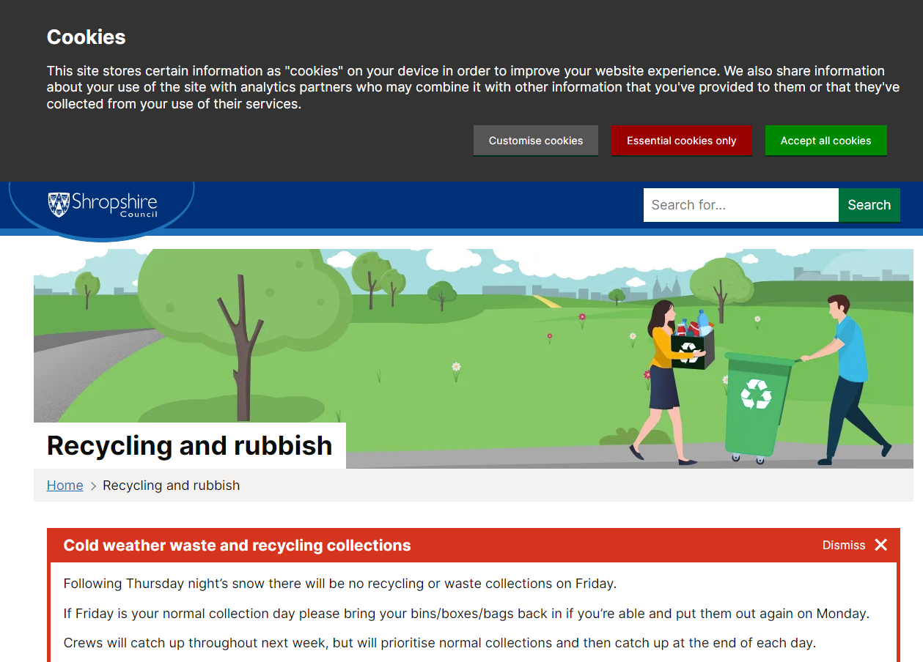
Website being reviewed
https://next.shropshire.gov.uk/recycling-and-rubbish/

Slide 66
Activity for Step 1: Identify the purpose
You have built a prototype of the Recycling and Rubbish website
Your questionnaire must find out:
How clear the information is
How easy it is to navigate
Whether the user can complete key tasks
What problems or confusion they experience
Write a short statement describing the purpose of your questionnaire.

Slide 67
2. Define the user group
Your questions must match who is giving the feedback:
Non‑technical users → focus on usability, clarity, task experience
Technical users → focus on logic, structure, validation, performance
Different users notice different things, so the questionnaire must reflect this.

Slide 68
Activity for Step 2: Define the user group
You are collecting feedback from a non‑technical user.
Your questions must match this user type.
Focus on:
Usability
Clarity
Ease of finding information
Task success
Write down who your user is and what they are expected to do.

Slide 69
3. Review the evidence the user will see
Users may:
Use the prototype directly
Watch a screencast (if no access)
View screenshots
Complete tasks in a guided session
Make sure the questions match the evidence shown.
If they watch a screencast, they must be able to answer based only on what they saw.

Slide 70
Activity for Step 3: Review the evidence the user will see
Your user will review:
Your prototype website
The specific pages you want feedback on
The tasks you ask them to complete
Choose 1–2 tasks from the Recycling and Rubbish site, such as:
Finding bin collection information
Checking what can be recycled
Locating a local recycling point
List the tasks you want your user to attempt.

Slide 71
4. Decide the question types
Closed
Open
Yes/No
Multiple choice
Rating scales
Used for patterns, comparisons, quick summaries.
Short explanations
Descriptions of problems
Suggested improvements
Used to explain why issues happened.

Slide 72
Activity for Step 4: Decide the question types
Create a draft list of questions that help evaluate your prototype.
Include:
Closed questions → clarity, ease, completion
Open questions → explanation of problems
Aim for:
3 closed questions
2 open questions
All linked to the tasks you selected.
Print the questions for peer review.

Slide 73
5. Write neutral, clear questions
Good questions:
Ask about one thing at a time
Avoid leading language
Are simple and direct
Match the task users completed or saw
Example (good):
“How clear were the instructions?”
Example (poor):
“Did you find the instructions confusing?” (leading)

Slide 74
Activity for Step 5: Write neutral, clear questions
Rewrite your questions so they are:
Short
Direct
Not leading
Easy for a non‑technical user to understand
Check that each question relates to an action or part of the Recycling and Rubbish website.

Slide 75
6. Cover the key areas being assessed
Non-technical users
Technical users
Was the task easy to complete?
Was the interface clear?
Did the system behave as expected?
Where did you get stuck?
Did the logic work for all inputs?
Were errors validated correctly?
Were there performance issues?
Was the structure clear?

Slide 76
Activity for Step 6: Cover the key areas being assessed
Add further questions that investigate:
How easy it was to find the information
How clear the page layout was
How confident the user felt
Where they got confused
Whether they completed the tasks successfully
Make sure your questions cover both usability and clarity.

Slide 77
7. Order the questions logically
A good sequence:
Start with simple closed questions
Move to usability and clarity
Then task difficulty
Finally open questions for detailed insights
This reduces cognitive load and improves response quality.

Slide 78
Activity for Step 7: Order the questions logically
Organise your questionnaire into a clear sequence:
Start → simple closed questions
Middle → navigation and clarity
End → open questions for detail
Check that your questionnaire flows naturally.

Slide 79
8. Pilot the questionnaire
Test it with:
A peer
Someone unfamiliar with the system
Check:
Do they understand all questions?
Are the questions relevant to the evidence?
Does it take the expected amount of time?
Fix unclear wording before using the questionnaire.

Slide 80
Activity for Step 8: Pilot the questionnaire
Swap with another student.
They should complete your questionnaire as if they were a non‑technical user.
Ask them:
Which questions were unclear?
Did any questions assume technical knowledge?
Use their feedback to improve your questionnaire.

Slide 81
9. Provide clear instructions to the user
Tell them:
What they are reviewing (system or screencast)
How long it will take
What they should focus on
That honest answers are important
This increases the reliability of results.

Slide 82
Activity for Step 9: Provide clear instructions to the user
Write a short introduction for your questionnaire.
Include:
What the prototype is (Recycling & Rubbish website)
What the user will do (complete tasks + give feedback)
How long it will take
Why their feedback matters
Keep the instructions short and neutral.

Slide 83
Activity for Step 9: Build your questionnaire
Create your questionnaire using Google Forms.
Add:
Your introduction
Your closed questions
Your open questions
A clear order that matches the user journey
Check everything is clear for a non‑technical user before sharing it.

Slide 84
10. Collect responses and analyse the data
Count closed question responses
Look for patterns
Compare answers from different user types
Use open question responses to explain the patterns
Link findings to system improvements

Slide 85
Activity: Share your questionnaire
Post your questionnaire link on the class Teams channel so your peers can access it easily.
Complete all questionnaires created by other students and give clear, honest feedback on their prototypes.
Base your answers only on the tasks shown in their Recycling and Rubbish website prototype.

Slide 86
Next steps
Next week we will review your questionnaire responses in detail and explore what the feedback reveals about usability and clarity.
We will look for patterns in user responses and identify improvements needed for your Recycling and Rubbish prototype.

Slide 87

Thursday Project

Slide 88
Activity: Create your questionnaire for a set task brief
Choose one of the set task briefs you have been working on and identify the part of your prototype site that is ready for testing.
Follow the worksheet and complete each step.

Slide 89
Activity: Share your questionnaire
Open your Google Form using the sharing link on your local browser, so it stays available at your desk for other students to use.
Invite students to move to your workstation to complete your questionnaire while viewing and testing your prototype site.
Make sure the prototype pages you want them to test are open and easy to access alongside the form.
Give clear, neutral instructions so users understand the task and can provide accurate feedback.

Slide 90

Repeat process for Technical user

Slide 91
Activity: Download your questionnaire responses and save to Teams
Open your Google Form and select Responses to view the data collected from your peers.
Click the ⋮ menu and choose Download responses (.csv) to save a copy of the results to your device.
Check that the file contains all completed responses before continuing.
Go to the original post in the class Teams channel and attach the downloaded files along with your completed worksheets.
Make sure files are clearly named with your name and if they are technical or non-technical users so they can be reviewed easily next lesson.

